Slide 1

MINDMELD
Interactive Cognitive Performance Tracking System
Agglomeration 1.0
Presented By:
Aarya Kachole
Divyansh Gupta
Prakhar Srivastava
Raghvan Pareek
Sumit Raj
Team: AG 13

Slide 2
Contents
01
02
03
04
Problem Statement
Task
Accomplished
Implementation
Journey
Login &
Register
05
06
07
08
Dashboard
Cognitive
Performance Tests
Learnings
Demo

Slide 3
Problem Statement
2
4
Need for
Cognitive
Monitoring
Interactive and Engaging Approach
Device
Independent
Solution
Performance
Analysis and
Feedback
1
3

Slide 4
Task Accomplished
User Registration and Personalization
Cognitive Performance Tests
Real-Time Feedback and Progress Tracking
Personalized Improvement Recommendations
Gamification and Motivation
Visualization and Analytics Dashboard

Slide 5
Implementation Journey
1
2
3
4
Backend
Set-Up
Login
Register
Test Score
Update
Dashboard
8
7
6
5
Minor Bug
Fix and
PPT
UI
Enhance-ments
Cognitive
Performance
Tests
Frontend
Set-Up

Slide 6
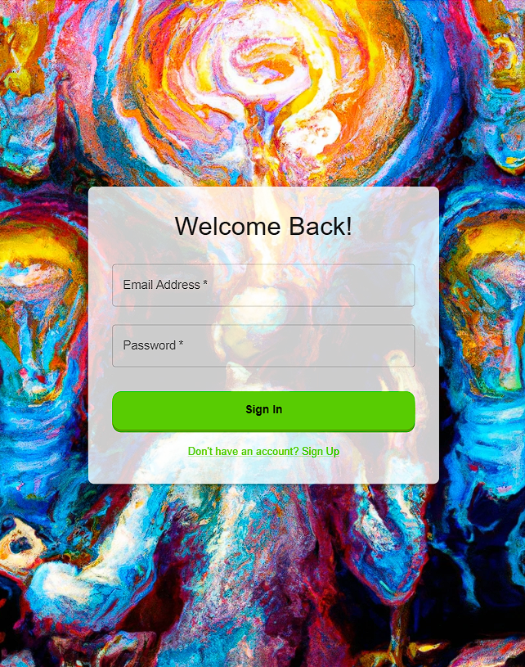
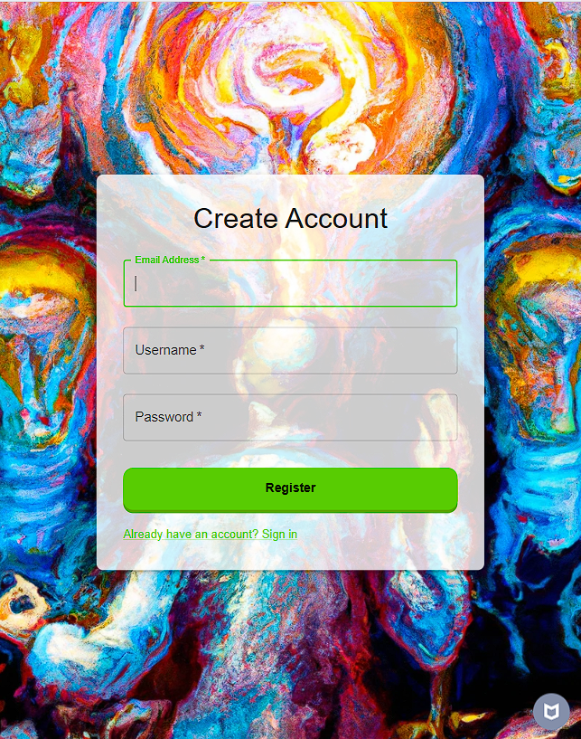
Login & Register

Slide 7
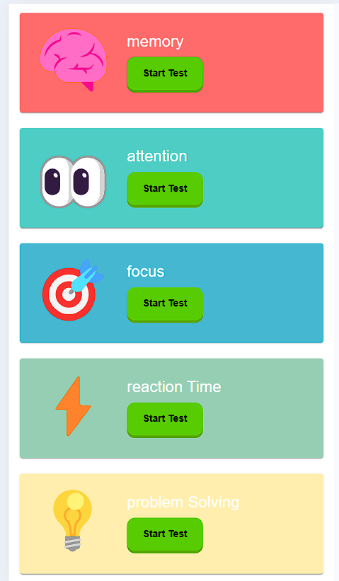
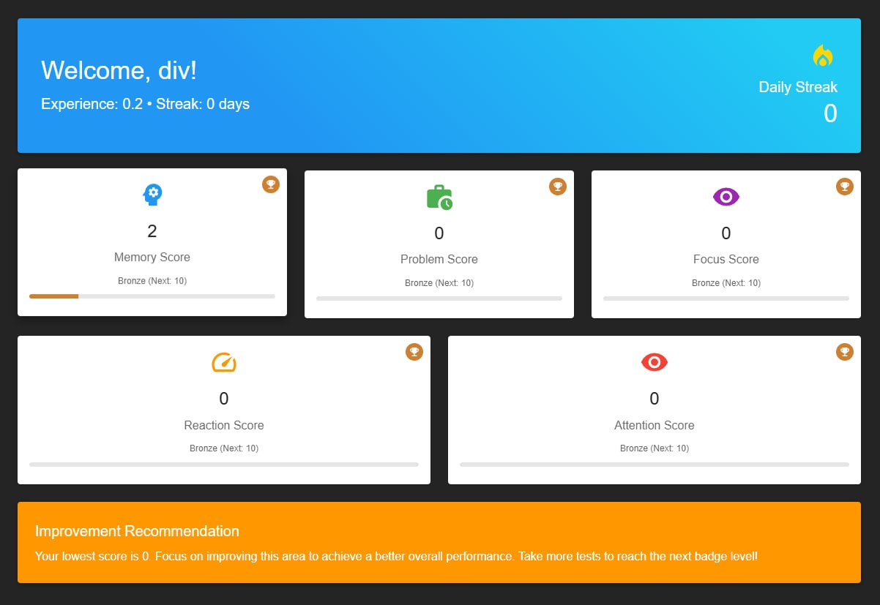
Dashboard

Slide 8
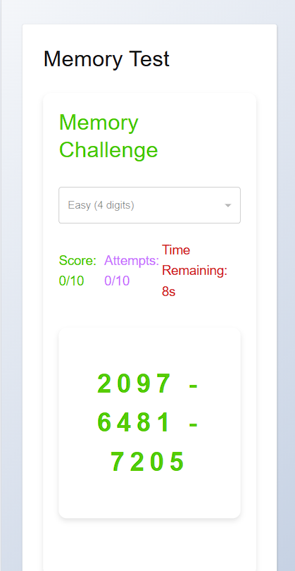
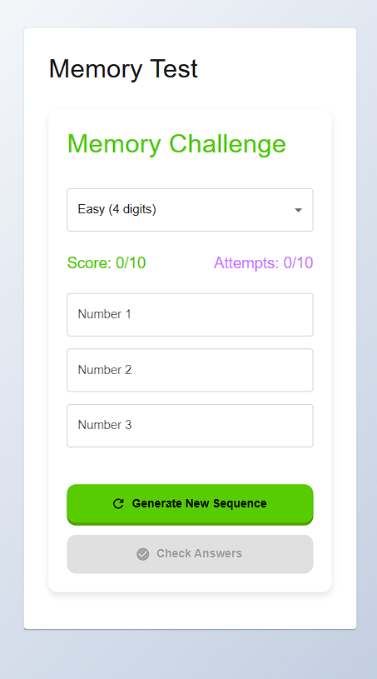
Memory Test

Slide 9
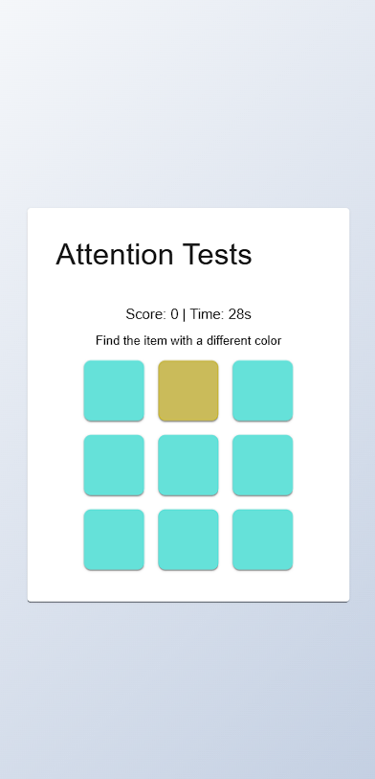
Attention Test: Odd One Out

Slide 10
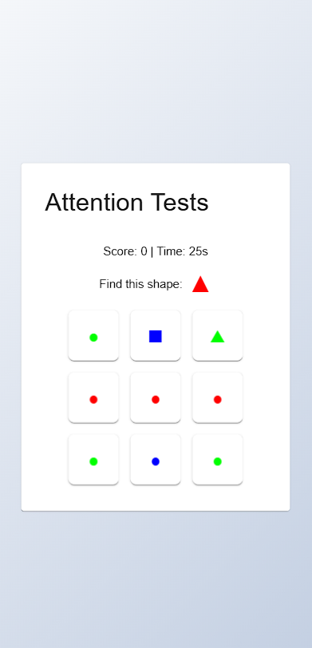
Attention Test: Visual Search

Slide 11
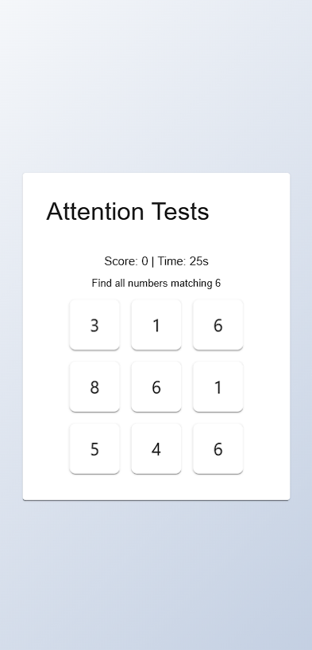
Attention Test: Number Matching

Slide 12
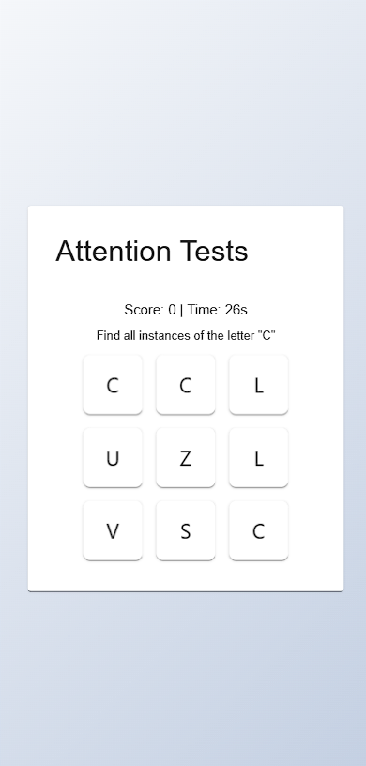
Attention Test: Letter Cancellation

Slide 13
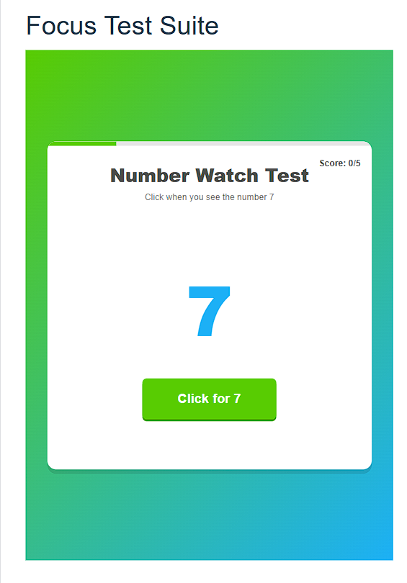
Focus Test: Continuous Attention

Slide 14
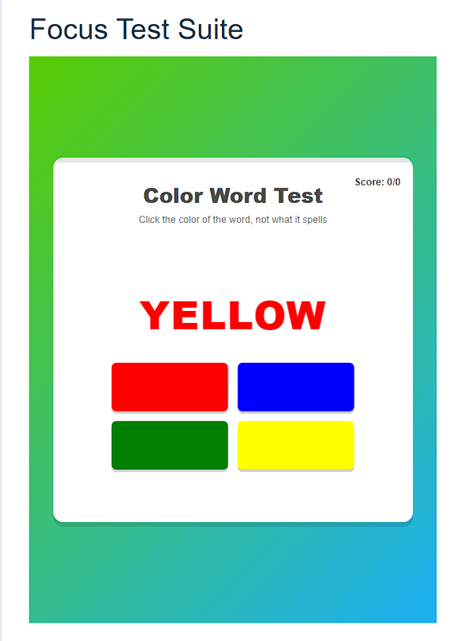
Focus Test: Stroop

Slide 15
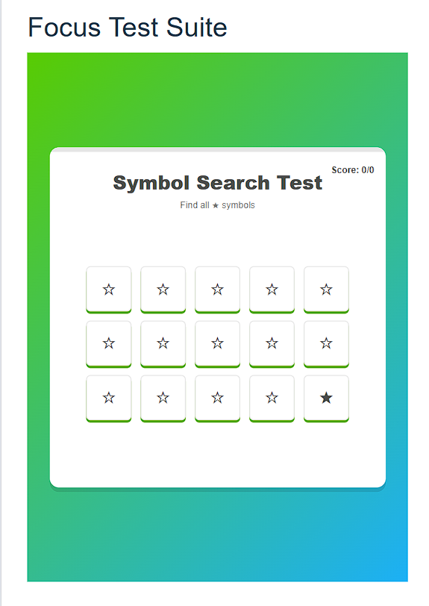
Focus Test: Distraction Filter

Slide 16
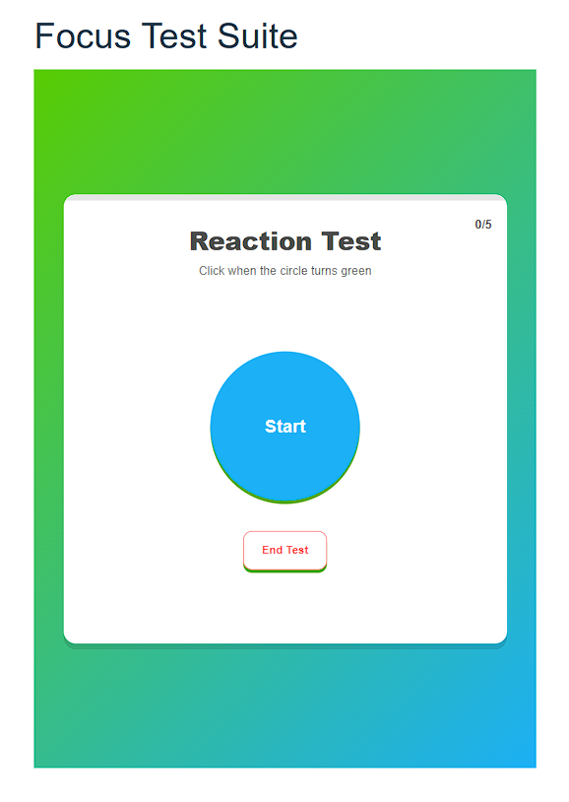
Focus Test: Reaction

Slide 17
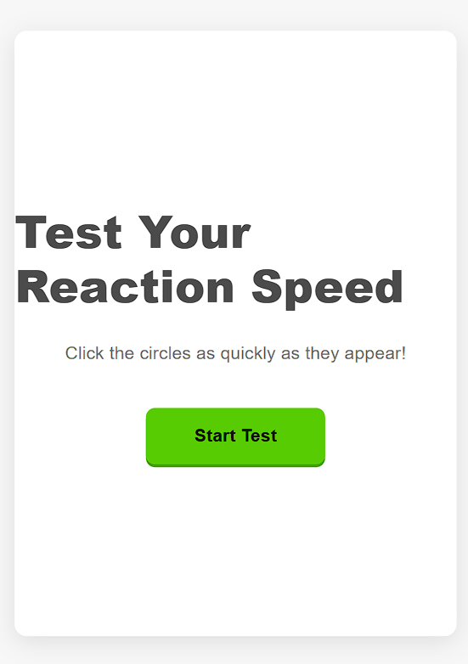
Reaction Time Test: Click Circle Test

Slide 18
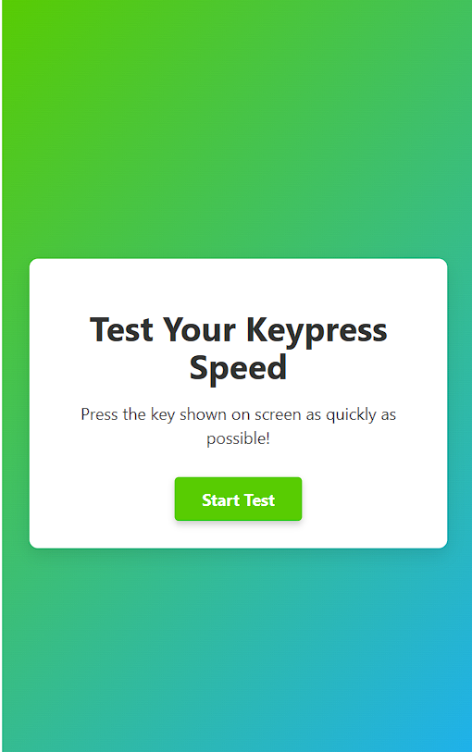
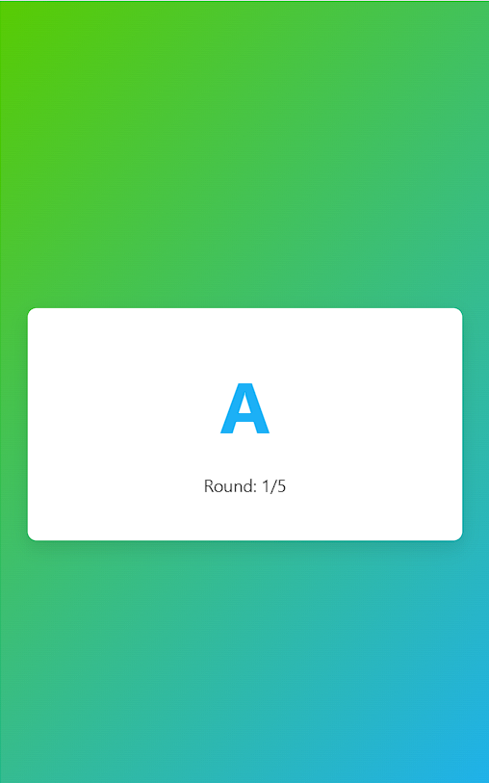
Reaction Time Test: KeyPress Test

Slide 19
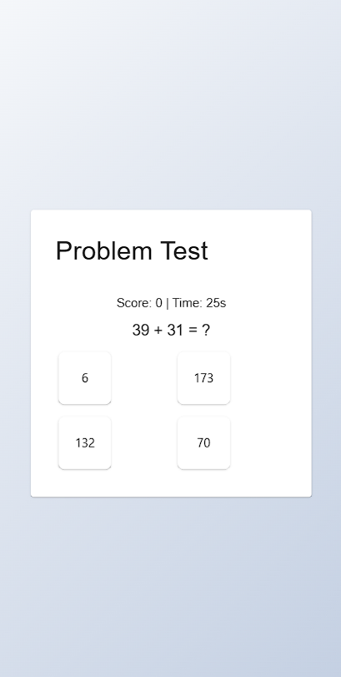
Problem-Solving Test

Slide 20
Learnings
AI Tool
Logical
Implementation
Team
Work
MERN
Time
Management
Psychology
Design

Slide 21
Demonstration

Slide 22
Thank you!

